Slide 1
ARULMIGU PALANIANDAVAR COLLEGE OF ARTS AND CULTURE, PALANI.
DEPARTMENT OF MATHEMATICS
COURSE NAME: DATA LITERACY WITH TABLEAU
PROJECT NAME: The Tableau HR scorecard measuring in tableau management Team member:
Leader:S.NAVEEN
MENTOR:
Dr .V.PANDIYAMMAL
Member:
P.VISHNU
K.NANDHA KUMAR
M.MUTHUMANICKAM
V.MOHANAKRISHNAN

Slide 2
Introduction of Tableau Desktop
Tableau is a powerful tool used for data analysis and visualization. It allows the creation of amazing and interactive visualization and that too without coding. It provides the features like cleaning, organizing and visualizing data.

Slide 3
FEATURE OF TABLEAU
TABLEAU DASHBOARD
COLLABORATION& SHARING
LIVE & IN- MEMORY DATA
DATA SOURCES
ROBUST SECURITY
MOBILE VIEW

Slide 4
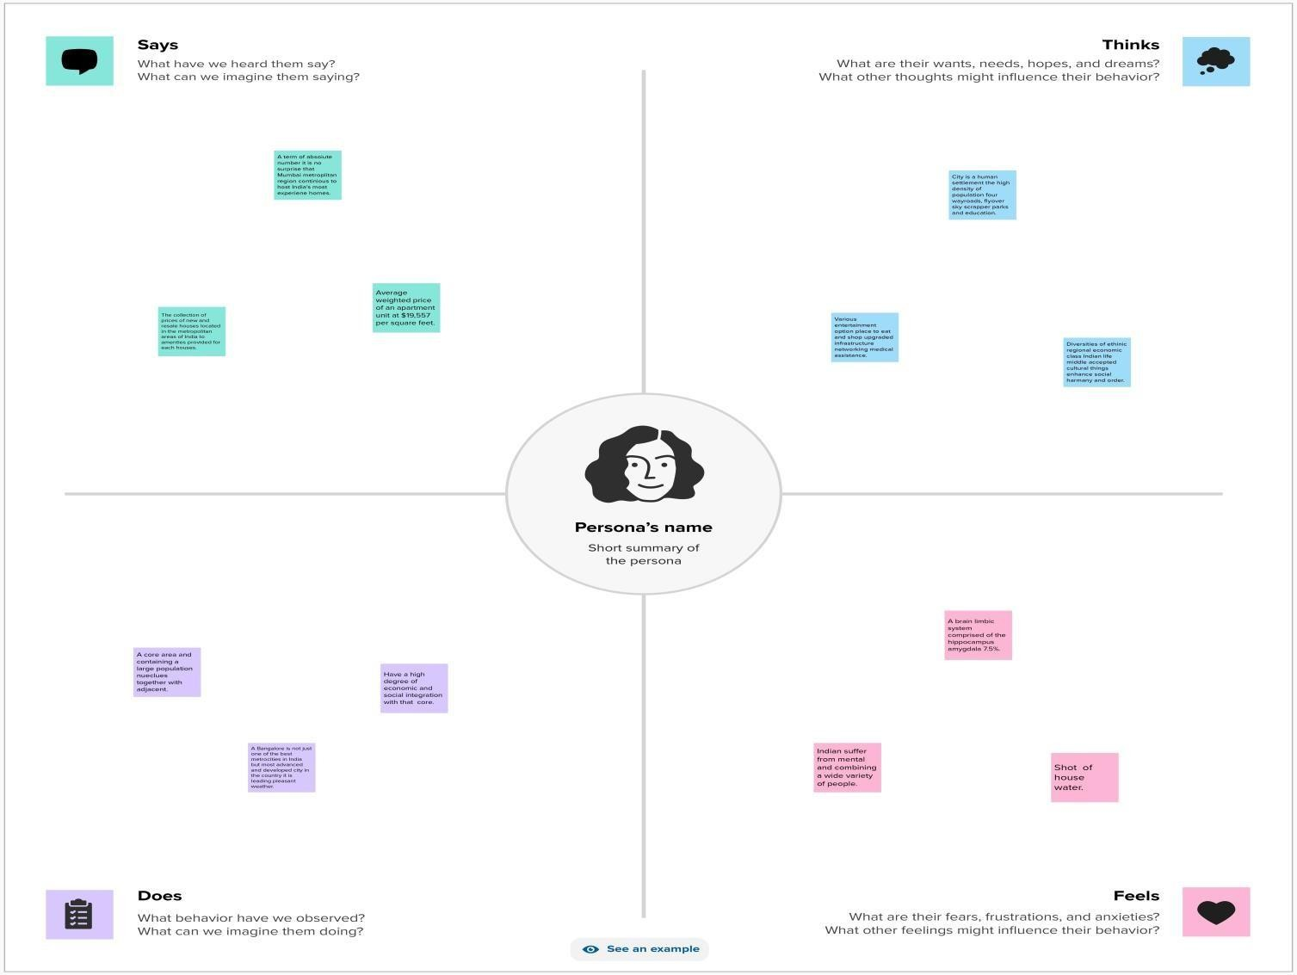
EMPATHY MAP
1

Slide 5
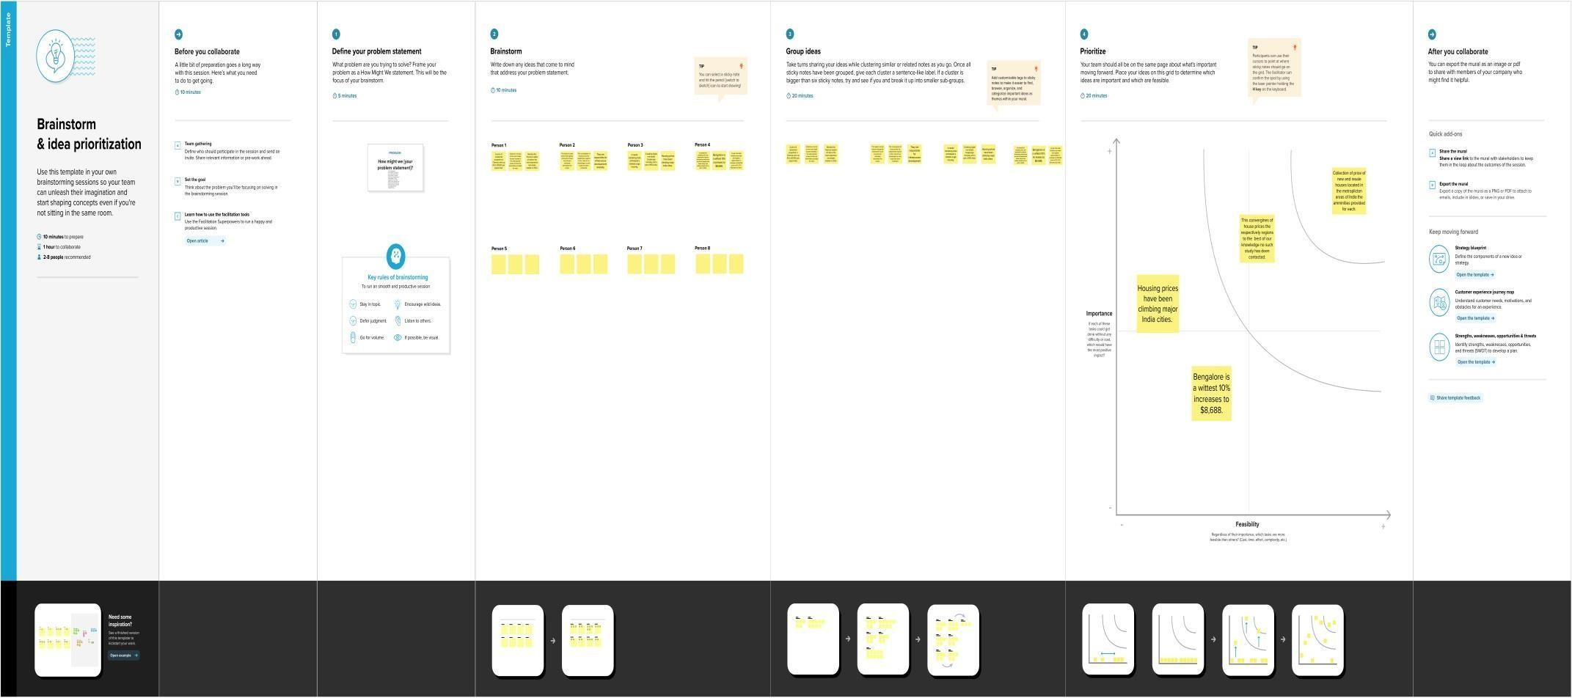
BRAIN STORM MAP

Slide 6
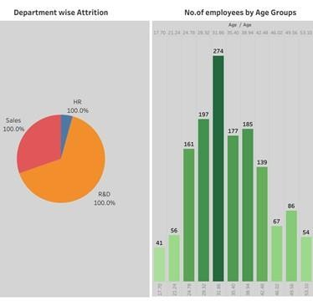
DASHBOARD 1

Slide 7
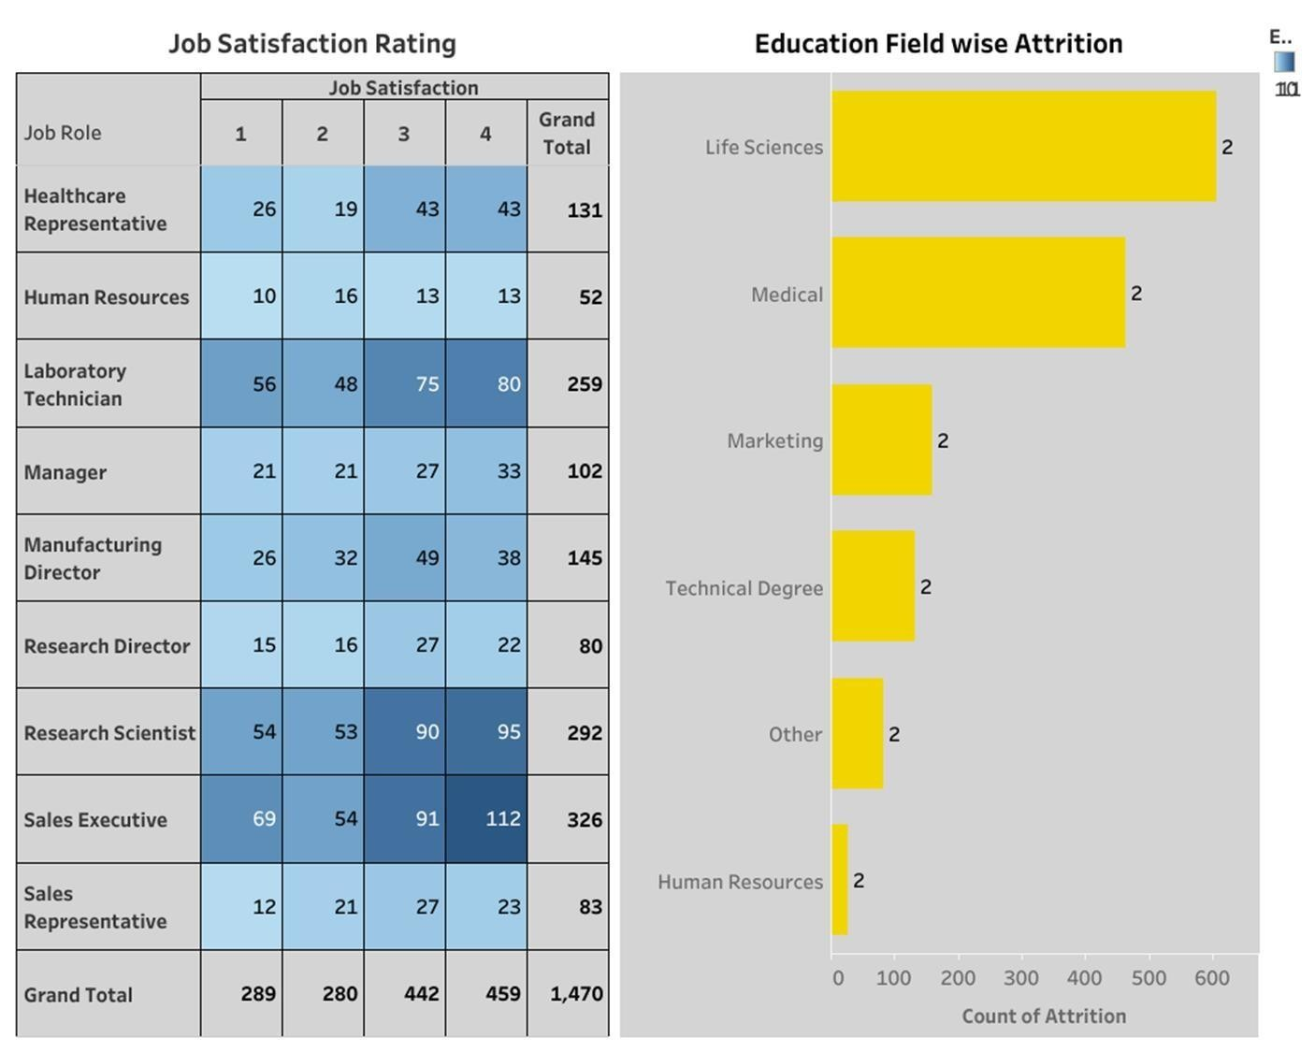
DASHBOARD 2

Slide 8
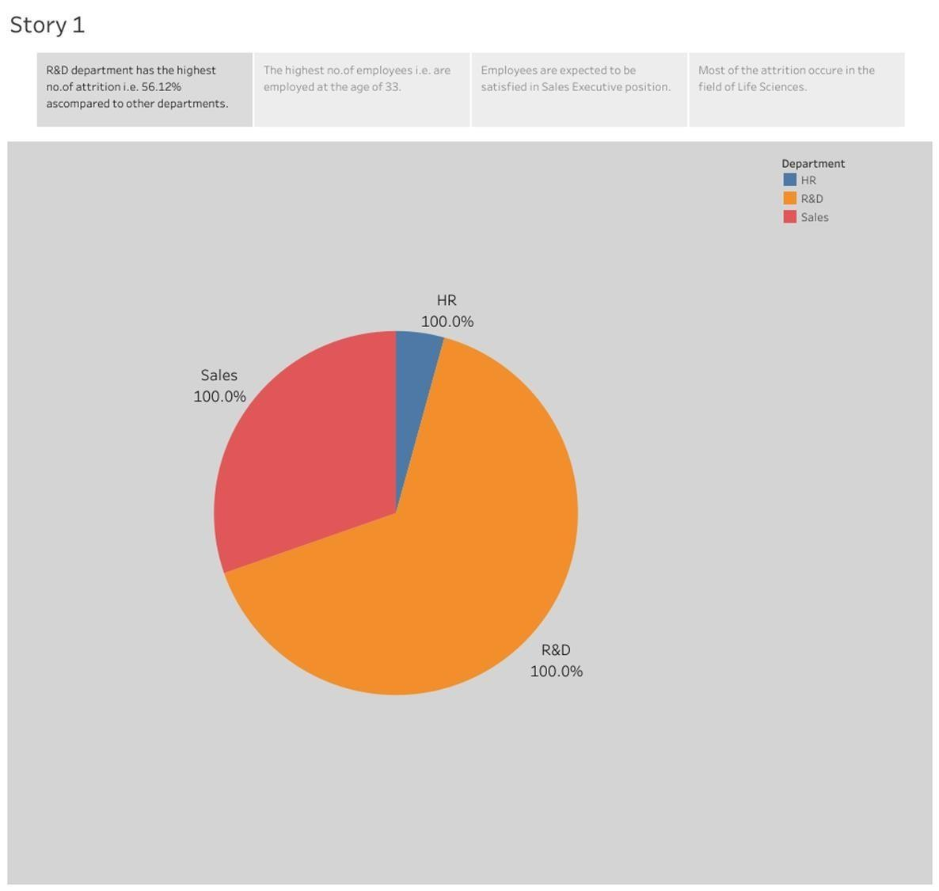
STORY 1

Slide 9
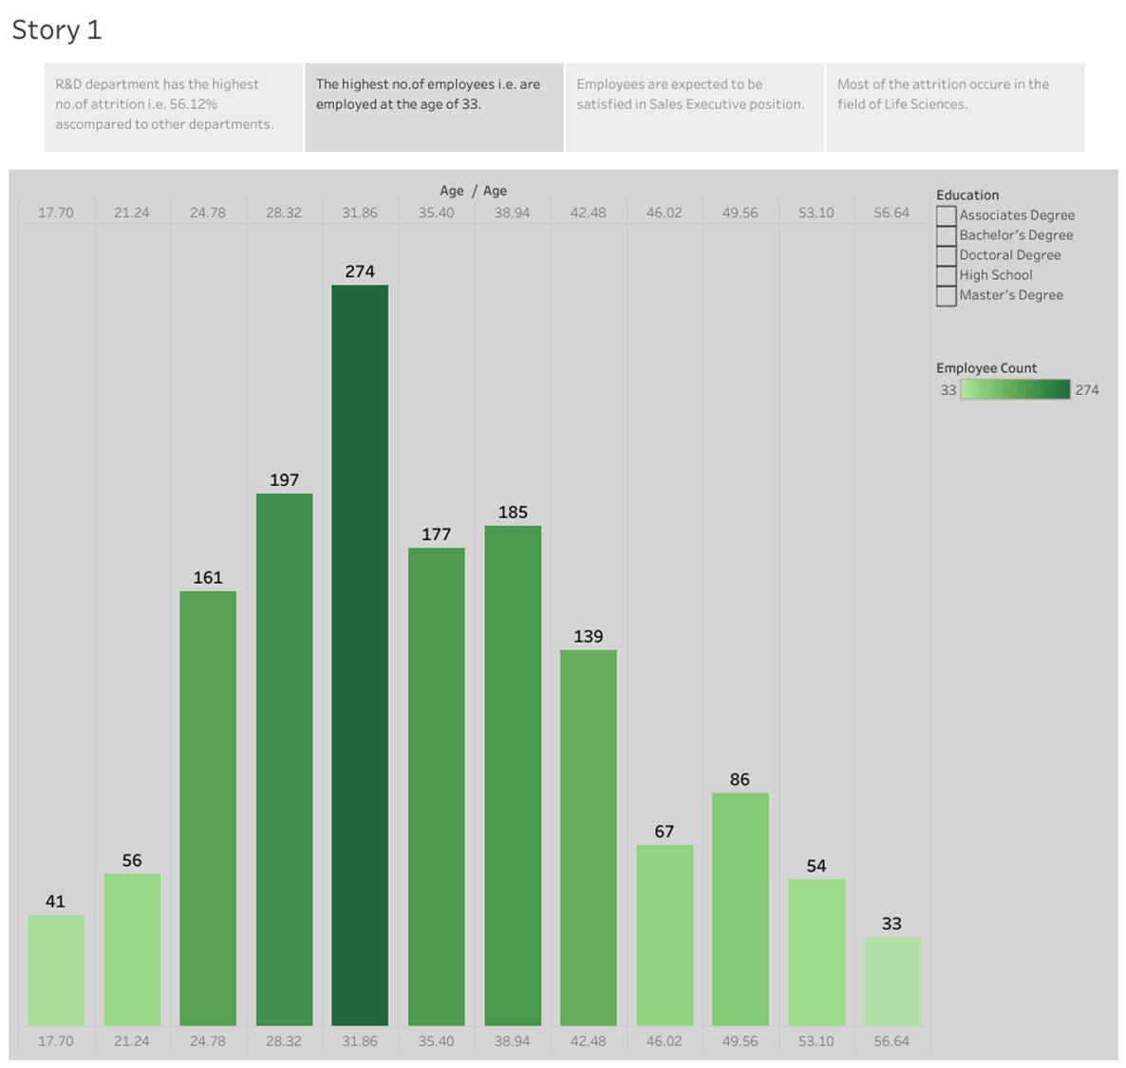
STORY 2

Slide 10
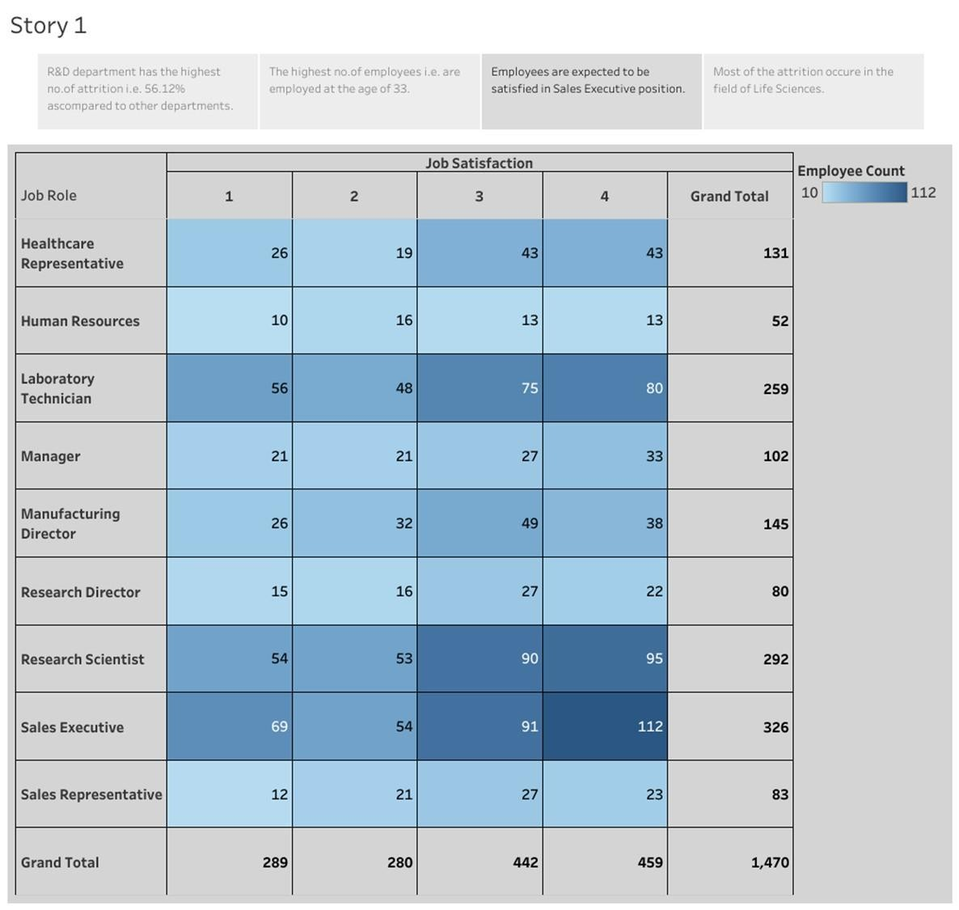
STORY 3

Slide 11
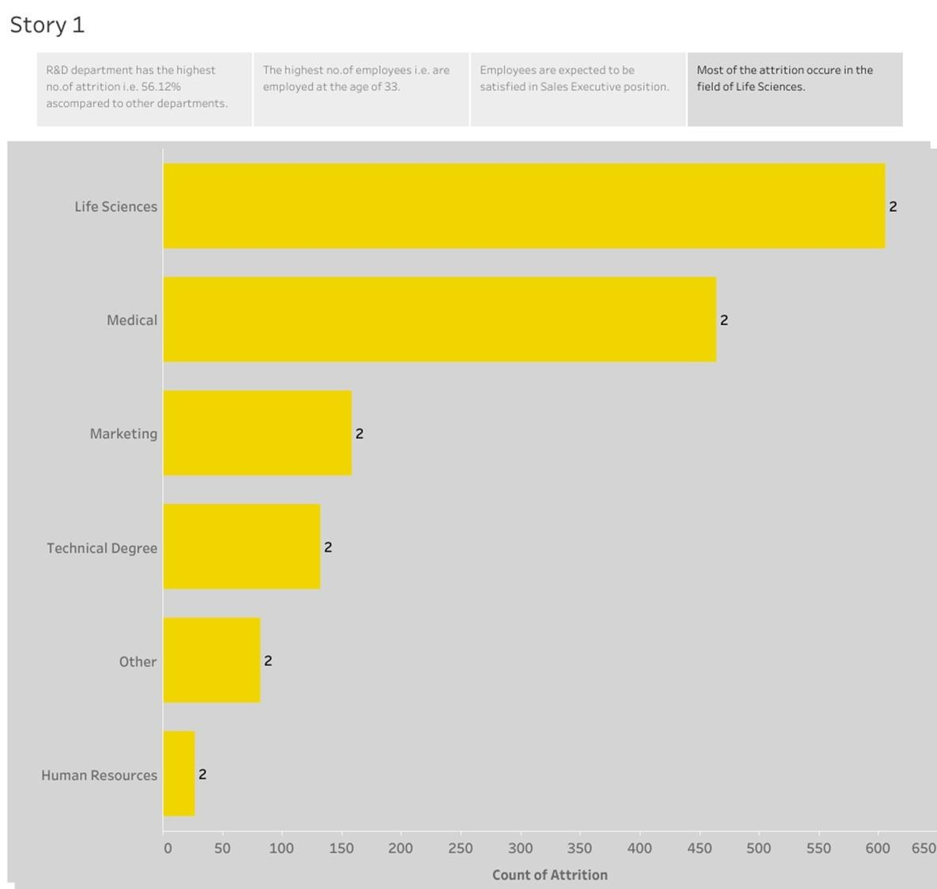
STORY 4

Slide 12
https://public.tableau.com/app/profile/naveen.s4356/vizzes
TABLEAU PUBLIC LINK

Slide 13
CONCLUSION:
Tableau is an excellent program to simplify all your data visualization activities and provide better and more accurate analysis if you ever tried data visualization and found it tough to grasp or too complex.

Slide 14


